Slide 1
Project Based Learning in JAVA Lab

Slide 2
Exp.-01
Objective:
Create an application to save the employee information using arrays having following fields:-
empid[] , depName[], empDes, empName[], dateJoin[] ,basic[], hra[], it[], DesCodes[].
Solve following programs:-
Salary should be calculated as (Basic +HRA + DA-IT)
Printing designation and da according to employee designation

Slide 3
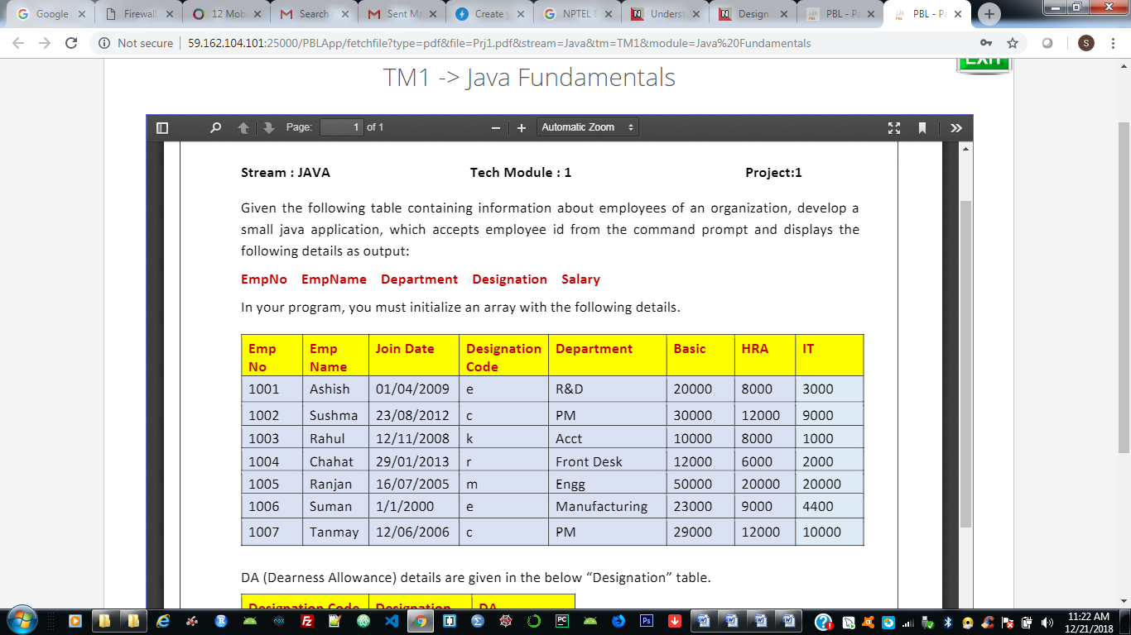

Slide 4
